Slide 1
Signal Processing on Databases
Jeremy Kepner
Lecture 3: Entity Analysis in Unstructured Data
This work is sponsored by the Department of the Air Force under Air Force Contract #FA8721-05-C-0002. Opinions, interpretations, recommendations and conclusions are those of the authors and are not necessarily endorsed by the United States Government.
Notes:
Title Slide

Slide 2
Outline
Introduction
Webolution
As is, is OK
D4M
Technologies
Results
Demo
Summary
Notes:
Outline slide.

Slide 3


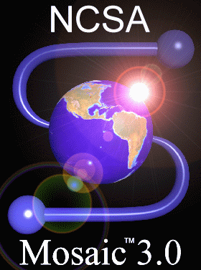

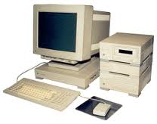
Primordial Web
Kepner & Beaudry 1992, Visual Intelligence Corp (now GE Intelligent Platforms)
Browser (html): | Server (http): Language: | Database (sql):
Client | Server | Database
http put
SQL
http get
data
Gopher
Browser GUI? HTTP for files? Perl for analysis? SQL for data?
A lot of work just to view data.
Won’t catch on.
Notes:
Original hardware/software architecture of the web consisted client, server and database.

Slide 4






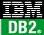







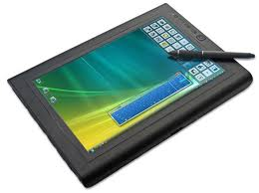
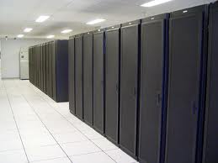


Cambrian Web
Browser (html): | Server (http): Language: | Database (sql):
Client | Server | Database
http put
SQL
http get
data
Browser GUI? HTTP for files? Perl for analysis? SQL for data?
A lot of work to view a little data.
Won’t catch on.
Notes:
Architecture has been populated with many solutions.

Slide 5
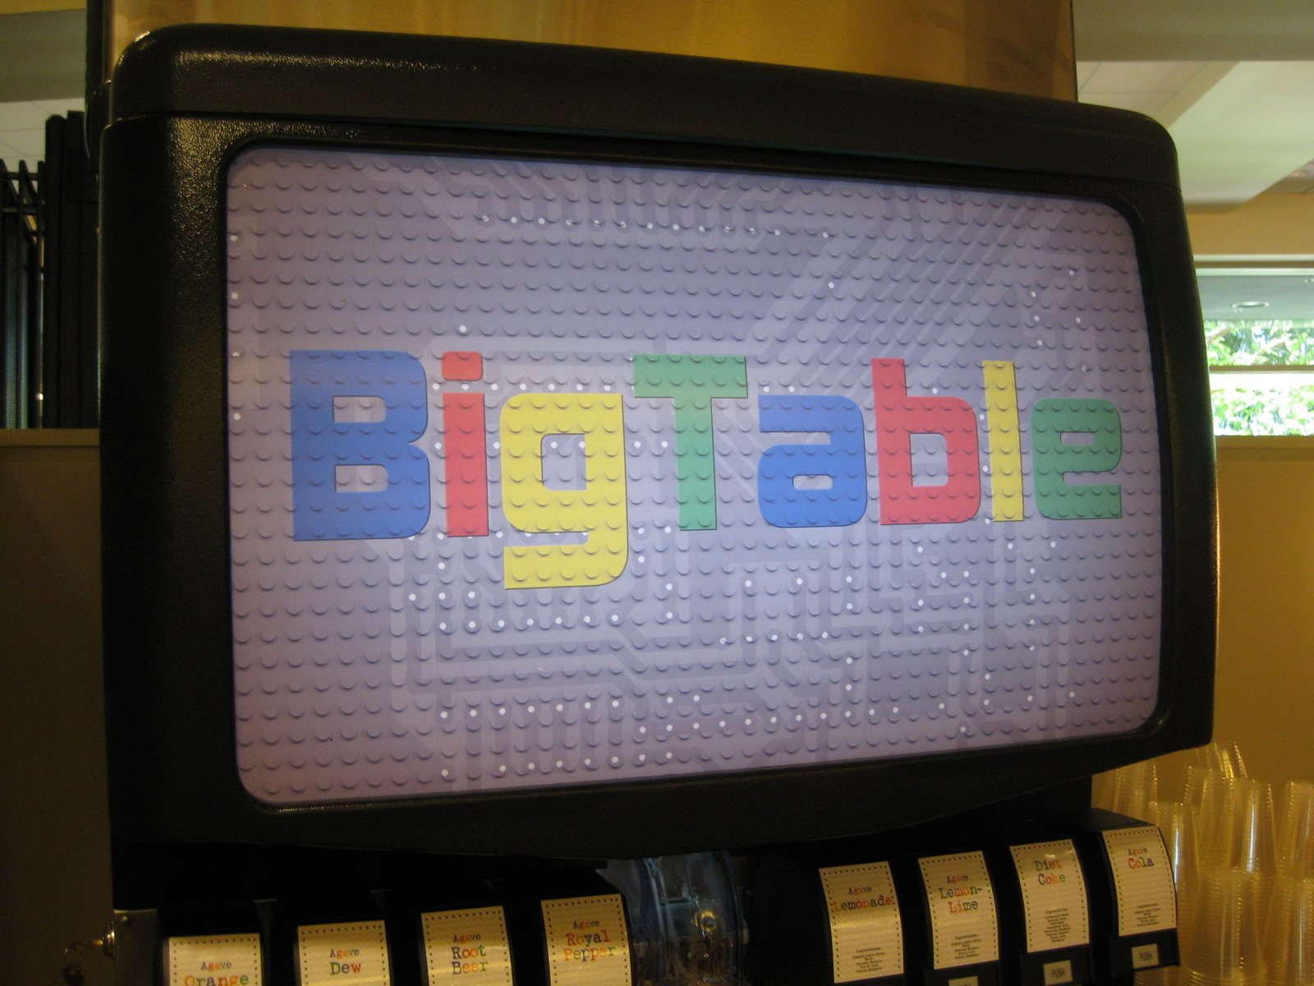
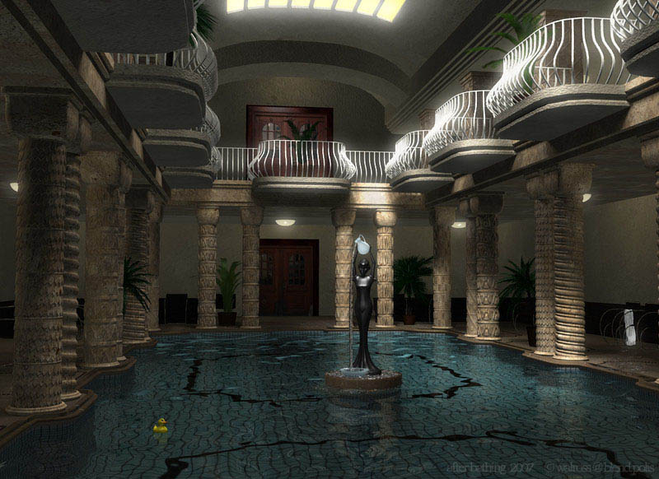
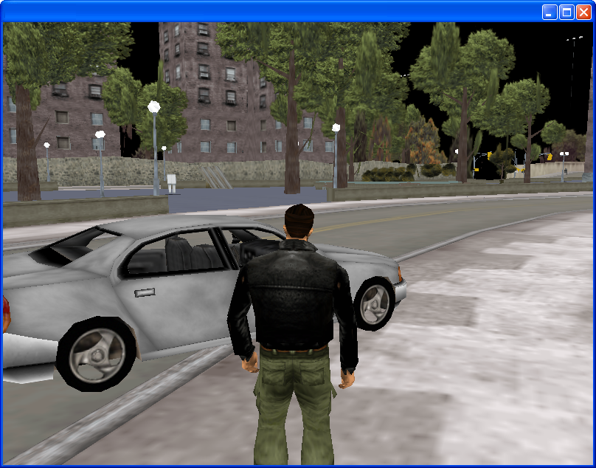



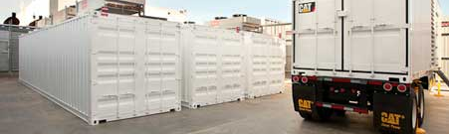
Modern Web
Game (data): | Server (http): Language: | Database (triples):
Client | Server | Database
http put
java
http get
data
Game GUI! HTTP for files? Perl for analysis? Triples for data!
A lot of work to view a lot of data.
Great view. Massive data.
Notes:
Client and database of original architecture has been replaced with game interface and triple store.

Slide 6
Modern Web
Game (data): | Server (http): Language: | Database (triples):
Client | Server | Database
http put
java
http get
data
Game GUI! HTTP for files? Perl for analysis? Triples for data!
A lot of work to view a lot of data. Missing middle.
Great view. Massive data.
Notes:
Server layer API has remained unchanged.

Slide 7

Future Web?
Game (data): | Server (files): Language: | Database (triples):
Client | Server | Database
graphs
graphs
graphs
graphs
portal
portal
Game GUI! Fileserver for files! D4M for analysis! Triples for data!
A little work to view a lot of data. Securely.
Great view. Massive data.
Notes:
D4M brings a new API to the server layer.

Slide 8

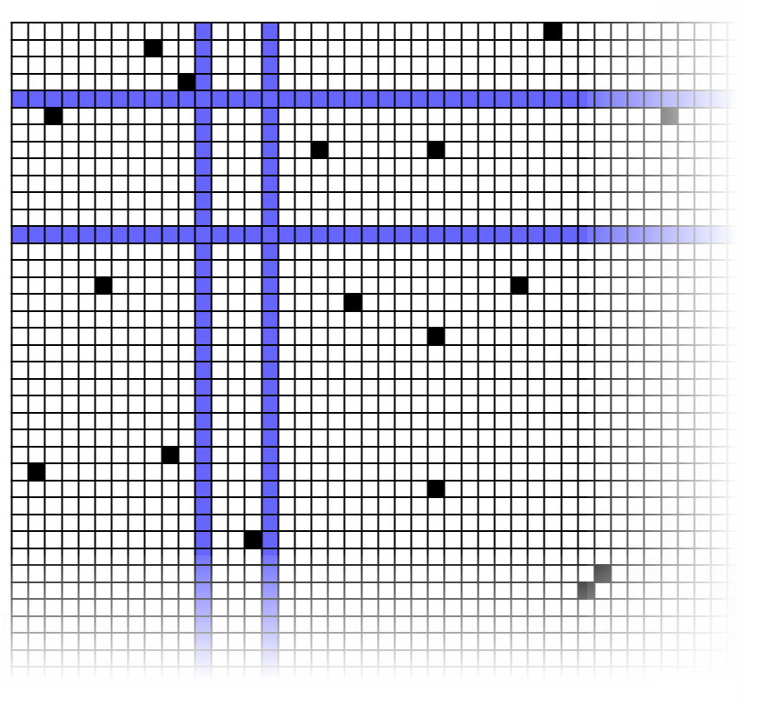
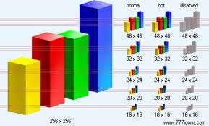
D4M: “Databases for Matlab”
Triple Store
Distributed Database
D4M
Dynamic
Distributed
Dimensional
Data
Model
Associative Arrays
Numerical Computing Environment
A
B
C
Query:
Alice
Bob
Cathy
David
Earl
E
D
A D4M query returns a sparse matrix or graph from Cloudbase…
Triple store are high performance distributed databases for heterogeneous data
…for statistical signal processing or graph analysis in MATLAB
D4M binds Associative Arrays to Triple Store, enabling rapid prototyping of data-intensive cloud analytics and visualization
Notes:
D4M provides an abstraction for interfacing between linear algebra and databases.

Slide 9
Outline
Introduction
Technologies
Hardware
Cloud software
Associative Arrays
Results
Demo
Summary
Notes:
Outline Slide

Slide 10
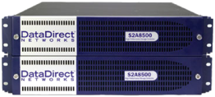
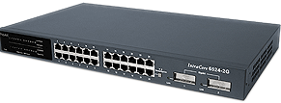
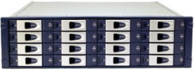
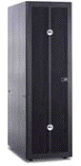


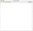
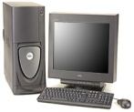

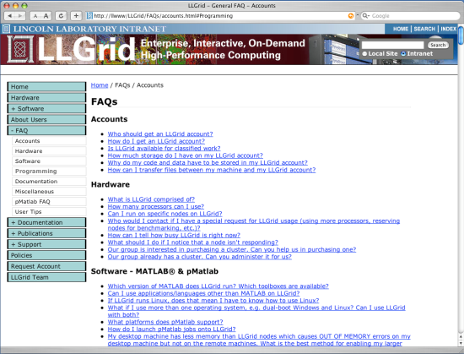
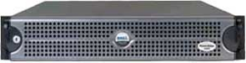
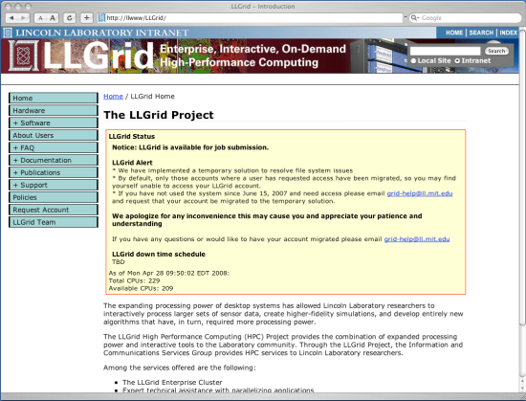


What is LL Grid?
Service Nodes
Compute Nodes
Cluster Switch
Users
Network
Storage
Resource Manager
FAQs
Configuration
Server
Web Site
LLAN
To Lincoln LAN
LAN Switch
LLGrid is a ~500 user ~2000 processor system
World’s only desktop interactive supercomputer
Dramatically easier to use than any other supercomputer
Highest fraction of staff using (20%) supercomputing of any organization on the planet
Foundation of Supercomputing in Massachusetts
Notes:
LLGrid is a large interactive supercomputer that serves a wide range of missions.

Slide 11
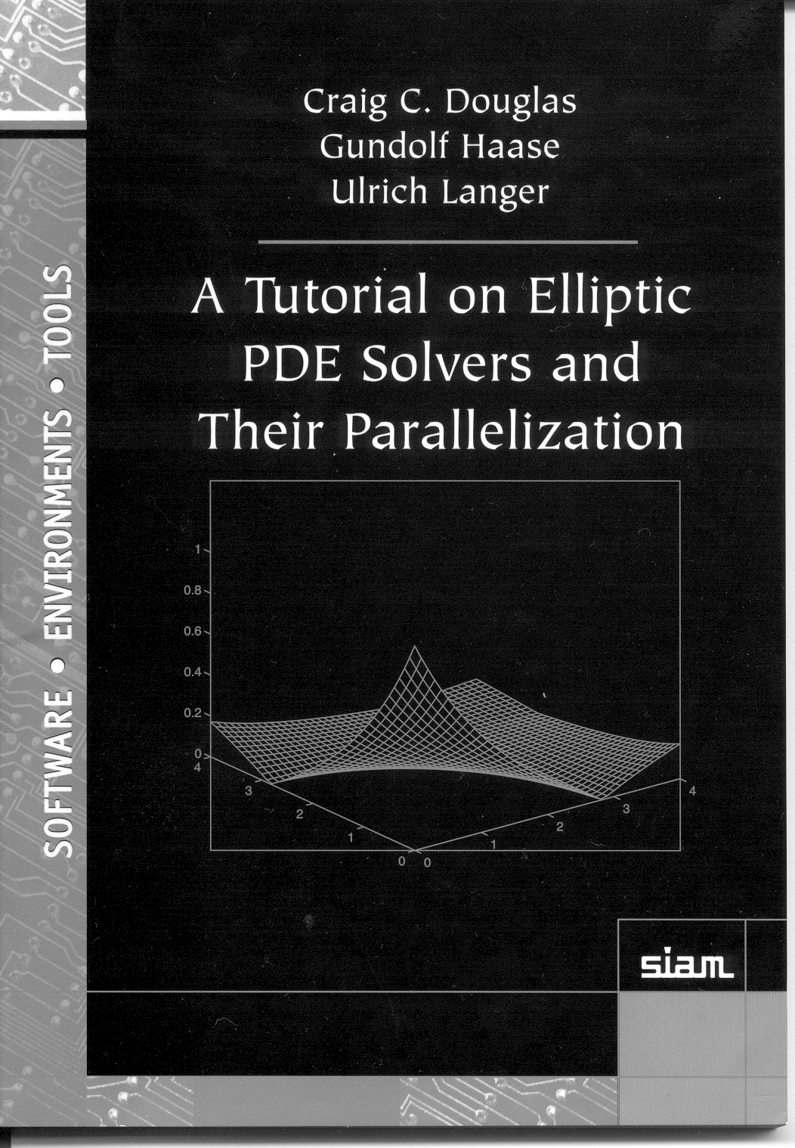
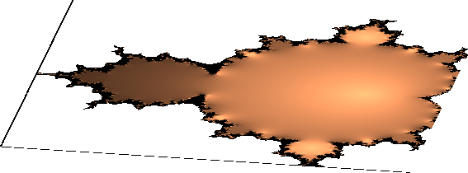
Why is LLGrid easier to use?
Universal Parallel Matlab programming
Jeremy Kepner
Parallel MATLAB
for Multicore and Multinode Computers
Amap = map([Np 1],{},0:Np-1);
Bmap = map([1 Np],{},0:Np-1);
A = rand(M,N,Amap);
B = zeros(M,N,Bmap);
B(:,:) = fft(A);
pMatlab runs in all parallel Matlab environments
Only a few functions are needed
Np
Pid
map
local
put_local
global_index
agg
SendMsg/RecvMsg
1
2
3
4
Distributed arrays have been recognized as the easiest way to program a parallel computers since the 1970s
Only a small number of distributed array functions are necessary to write nearly all parallel programs
LLGrid is the first system to deploy interactive distributed arrays
Notes:
11
Universal API for parallel Matlab programming.

Slide 12












Cloud Computing Concepts
Data Intensive Computing
Utility Computing
Compute architecture for large scale data analysis
Billions of records/day, trillions of stored records, petabytes of storage
Google File System 2003
Google MapReduce 2004
Google BigTable 2006
Design Parameters
Performance and scale
Optimized for ingest, query and analysis
Co-mingled data
Relaxed data model
Simplified programming
Community:
Compute services for outsourcing IT
Concurrent, independent users operating across millions of records and terabytes of data
IT as a Service
Infrastructure as a Service (IaaS)
Platform as a Service (PaaS)
Software as a Service (SaaS)
Design Parameters
Isolation of user data and computation
Portability of data with applications
Hosting traditional applications
Lower cost of ownership
Capacity on demand
Community:
Notes:
12
Cloud computing concepts promise such distributed storage and processing.
But first we must disambiguate between two areas of cloud computing: utility computing and data intensive computing
12

Slide 13




The Big Four Cloud Ecosystems
Enterprise
Supercomputing
IaaS
- Interactive
- On-demand
- Elastic
PaaS
- High performance
- Parallel Languages
- Scientific computing
PaaS
- Java
- Map/Reduce
- Easy admin
SaaS
- Indexing
- Search
- Security
Big Data
DBMS
Each ecosystem is at the center of a multi-$B market
Pros/cons of each are numerous; diverging hardware/software
Some missions can exist wholly in one ecosystem; some can’t
IaaS: Infrastructure as Service
PaaS: Platform as a Service
SaaS: Software as a Service
Notes:
Currently there are four ecosystems that dominates large scale computing applications. They have their own pros and cons.

Slide 14
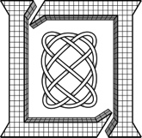


The Big Four Cloud Ecosystems
Enterprise
LLGrid
Supercomputing
IaaS
- Interactive
- On-demand
- Elastic
PaaS
- High performance
- Parallel Languages
- Scientific computing
PaaS
- Java
- Map/Reduce
- Easy admin
SaaS
- Indexing
- Search
- Security
Big Data
DBMS
LLGrid provides interactive, on-demand supercomputing
Accumulo database provides high performance indexing, search, and authorizations within a Hadoop environment
IaaS: Infrastructure as Service
PaaS: Platform as a Service
SaaS: Software as a Service
Notes:
LLGrid provides Enterprise level interactive, on-demand and elastic computing environment in a supercomputing environment. So LLGrid environment provides both Enterpris and Supercomputing features within the environment. Accumulo and Hbase databases are enhancing Hadoop HDFS technology by providing high performance indexing, search, and authorizations within a Hadoop environment.

Slide 15

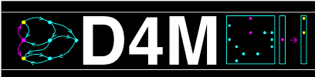
The Big Four Cloud Ecosystems
Enterprise
LLGrid
Supercomputing
IaaS
- Interactive
- On-demand
- Elastic
PaaS
- High performance
- Parallel Languages
- Scientific computing
MapReduce
PaaS
- Java
- Map/Reduce
- Easy admin
SaaS
- Indexing
- Search
- Security
Big Data
DBMS
LLGrid MapReduce provides map/reduce interface to supercomputing
D4M provides an interactive parallel scientific computing environment to databases
IaaS: Infrastructure as Service
PaaS: Platform as a Service
SaaS: Software as a Service
Notes:
LLGrid_MapReduce and D4M is designed to provide an easy-to-use interface to map/reduce supercomputing and an interactive parallel scientific computing environment to databases.

Slide 16
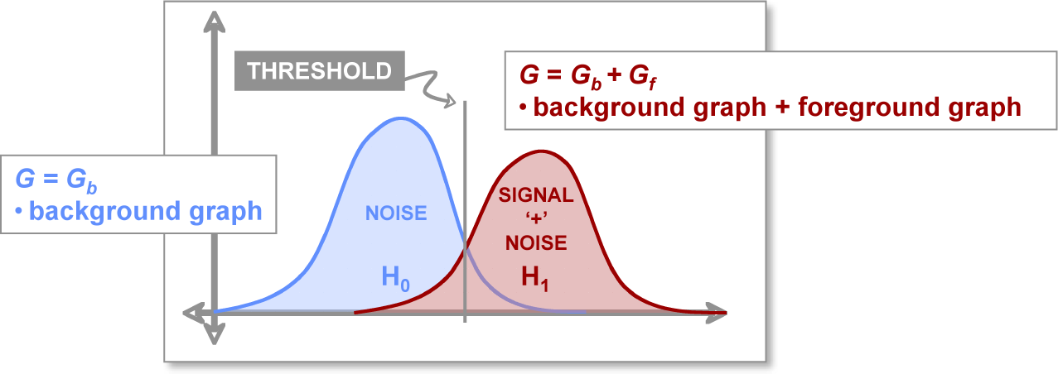
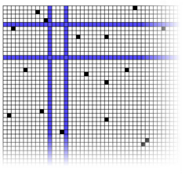
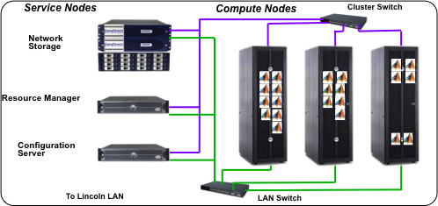
Big Compute + Big Data Stack
Novel Analytics for:
Text, Cyber, Bio
Weak Signatures,
Noisy Data,
Dynamics
A
B
High Level Composable API: D4M (“Databases for Matlab”)
Array Algebra
C
E
Distributed Database: Accumulo/HBase (triple store)
Distributed Database/ Distributed File System
High Performance Computing: LLGrid + Hadoop
Interactive Super-computing
Combining Big Compute and Big Data enables entirely new domains
Notes:
Exploiting big data requires new software across the entire stack.

Slide 17
Hadoop Architecture Overview
JobTracker
TaskTracker
TaskTracker
TaskTracker
Hadoop cluster
NameNode
DataNode
DataNode
DataNode
Hadoop MapReduce Jobs
Notes:
Hadoop architecture is explained : Key components in Hadoop Distributed File System and Hadoop MapReduce Framework.

Slide 18
Hadoop: Strengths and Weaknesses
What works well
Distributed processing of large data
Indexing log files
Sorting data
Scale up from single servers to thousands of machines
Local computation and storage
Detect and handle failures at the application layer
Highly-available service on top of a cluster of computers
Some difficulties are
Controlling compute resources for a given job
Full blown, greedy scheduling
Multi-user environments
Not easy to provide fair-share control on their use of Hadoop cluster
Non-Java programmers
Takes time to learn the parallel programming API for Java
Notes:
Hadoop offers many services but also has limitations.

Slide 19
LLGrid_MapReduce Architecture
1
input
a
b
output
a.out
b.out
scan
scan
4
LLGrid_MapReduce
Mapper Task 1
Reduce Out
Reduce Task
Mapper Task 2
5
Scheduler
2
3
Set dependency on Mapper Tasks
LLGrid MapReduce provides a language agnostic and scheduler agnostic map/reduce interface in a supercomputing environment
Notes:
This shows LLGrid_MapReduce architecture. LLGrid_Mapper will scan the input directory and check how many input files are there. Then, it will generate a unique run script for each input file and submit an array job to the scheduler. It will also save its job ID number in a file, MapJobID, at the current working directory. If needed, it can create a dependent Reduce job. The Reduce job will wait until all the Map tasks are completed.

Slide 20
Outline
Introduction
Technologies
Hardware
Cloud software
D4M
Results
Demo
Summary
Notes:
Outline slide.

Slide 21
Multi-Dimensional Associative Arrays
Extends associative arrays to 2D and mixed data types
A('alice ','bob ') = 'cited '
or A('alice ','bob ') = 47.0
Key innovation: 2D is 1-to-1 with triple store
('alice ', bob ','cited ’)
or ('alice ','bob ',47.0)
bob
cited
alice
alice
bob
Notes:
D4M unifies fou4 abstractions into one view.

Slide 22
Composable Associative Arrays
Key innovation: mathematical closure
all associative array operations return associative arrays
Enables composable mathematical operations
A + B A - B A & B A|B A*B
Enables composable query operations via array indexing
A('alice bob ',:) A('alice ',:) A('al* ',:)
A('alice : bob ',:) A(1:2,:) A == 47.0
Simple to implement in a library (~2000 lines) in programming environments with: 1st class support of 2D arrays, operator overloading, sparse linear algebra
Complex queries with ~50x less effort than Java/SQL
Naturally leads to high performance parallel implementation
Notes:
D4M is composable and leads to much smaller analytics.

Slide 23
Universal “Exploded” Schema
Triple Store Table: Ttranspose
Input Data
 | 2001-01-01 | 2001-01-02 | 2001-01-03
src_ip/a | 1
src_ip/b |  | 1
domain/b |  | 1
domain/c |  |  | 1
dest_ip/a | 1
dest_ip/c |  |  | 1
Time | src_ip | domain | dest_ip
2001-01-01 | a |  | a
2001-01-02 | b | b
2001-01-03 |  | c | c
 | src_ip/a | src_ip/b | domain/b | domain/c | dest_ip/a | dest_ip/c
2001-01-01 | 1 |  |  |  | 1
2001-01-02 |  | 1 | 1
2001-01-03 |  |  |  | 1 |  | 1
Triple Store Table: T
Key Innovations
Handles all data into a single table representation
Transpose pairs allows quick look up of either row or column
Notes:
Triples stores can be organized so to allow rapid access to both columns and rows.

Slide 24
Outline
Introduction
Technologies
Results
Benchmark performance
Facet search
Management and monitoring
Demo
Summary
Notes:
Outline slides.

Slide 25
Stats Diagram
Triple Store Table: T
src_ip/a
domain/b
domain/d
dest_ip/d
domain/a
domain/c
dest_ip/b
src_ip/b
src_ip/d
dest_ip/a
dest_ip/c
src_ip/c
Recv/b
Recv/d
Recv/a
Recv/c
Recv/e
Row | Key (time)
1 | 2001-10-01 01 01 00
2 | 2001-10-01 01 02 00
3 | 2001-10-01 01 03 00
4 | 2001-10-01 01 04 00
5 | 2001-10-01 01 05 00
6 | 2001-10-01 01 06 00
Associative Array: A
Copy a set of rows from T into associative array A
Perform the following statistical calculations on A
Column count: how many times each column appears in A
Column type count: how many times each column type appears in A
Column covariance: how many times a each pair of columns in A appear in the same row together
Column covariance: how many times a each pair of column types in A appear in the same row together
Good for identifying column types, gaps, clutter, and correlations
Notes:
Example of how a statistics can be quickly computed from a network log.

Slide 26
Stats Diagram
UNCLASSIFIED // FOR OFFICIAL USE ONLY
Triple Store Table: T
src_ip/a
domain/b
domain/d
dest_ip/d
domain/a
domain/c
dest_ip/b
src_ip/b
src_ip/d
dest_ip/a
dest_ip/c
src_ip/c
Recv/b
Recv/d
Recv/a
Recv/c
Recv/e
Row | Key (time)
1 | 2001-10-01 01 01 00
2 | 2001-10-01 01 02 00
3 | 2001-10-01 01 03 00
4 | 2001-10-01 01 04 00
5 | 2001-10-01 01 05 00
6 | 2001-10-01 01 06 00
Associative Array: A
Copy a set of rows from T into associative array A
Perform the following statistical calculations on A
Column count: how many times each column appears in A
Column type count: how many times each column type appears in A
Column covariance: how many times a each pair of columns in A appear in the same row together
Column covariance: how many times a each pair of column types in A appear in the same row together
Good for identifying column types, gaps, clutter, and correlations
UNCLASSIFIED // FOR OFFICIAL USE ONLY

Slide 27
Stats Implementation
Define a set of rows
r = '2001-01-01 01 02 00,2001-01-01 01 03 00, 2001-01-01 01 04 00,'
Copy rows from table to associative array and convert '1' to 1
A = double(logical(T(r,:)))
A = A(:,'src_ip/ *,domain/ *,dest_ip/ *,')
Find popular columns counts
sum(A,1) > 200
Find popular pairs
A’ * A > 200 or sqIn(A) > 200
Find domains with many dest IPs
sum(double(logical(sqIn(A))),2) > 3

Slide 28
Count
Events
Very easy to get elementary count info necessary for finding clutter and anomalies
Notes:
Example output of statistics.

Slide 29
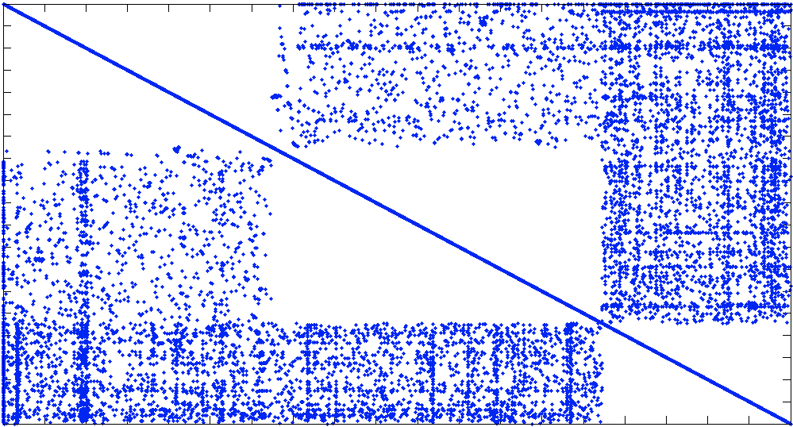
Covariance
UNCLASSIFIED // FOR OFFICIAL USE ONLY
dest_ip
domain
src_ip
dest_ip
domain
src_ip
Adjacency matrix a natural result of covariance calculation
UNCLASSIFIED // FOR OFFICIAL USE ONLY
Notes:
Covariances are a natural byproduct of D4M.

Slide 30
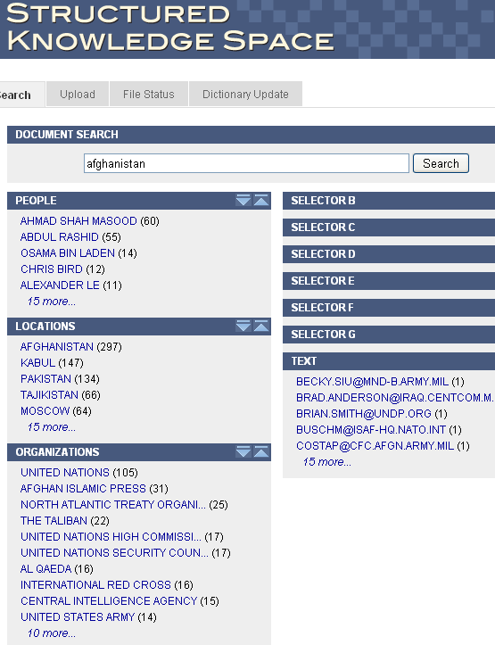
Facet Search
Core analytic of SKS
Give keyword distribution of a set of documents that share a common keyword(s)
Provides useful guide to what keyword to select next
Currently implemented with several hundreds of lines of Java/SQL
Associative array implementation has 1 line
Notes:
Facets search is a complex analytics that can be quickly implemented in D4M.

Slide 31
Facet Search Algorithm
NY
DC
IMF
UN
Alice
Bob
Carl
Associative array relates documents to place, org and person entities
A(x,y) : S^{NxM} → R
Facets y₁=UN, y₂=Carl
Documents that contain both
A(:,y₁) & A(:,y₂)
Entity counts in the above set of documents obtained via matrix multiply
( A(:,y₁) & A(:,y₂) )^{t} A
a.txt
b.doc
c.pdf
d.htm
e.ppt
f.txt
g.doc
1 2 1 2
Notes:
31
Facet search can be implement in 3 lines of D4M mathematics.

Slide 32
Outline
Introduction
Technologies
Results
Demo
Summary
Notes:
Outline slide

Slide 33
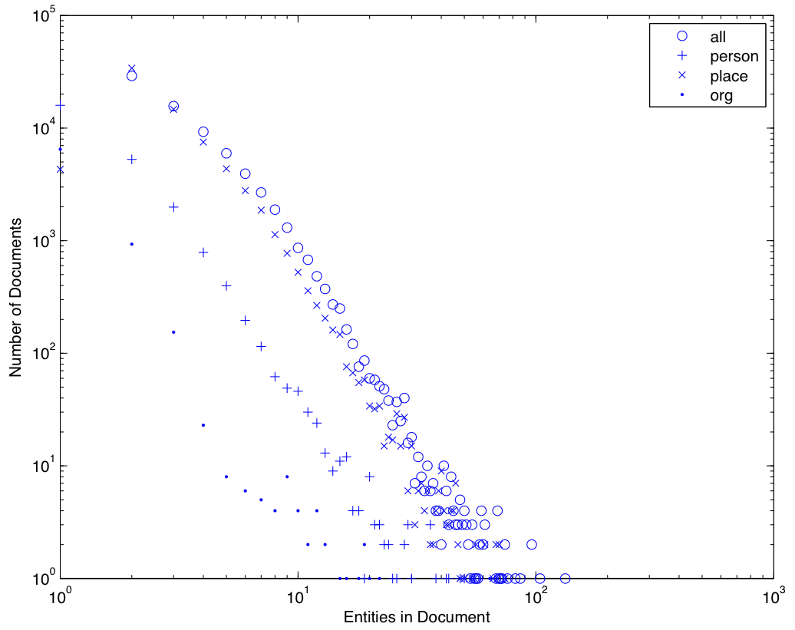
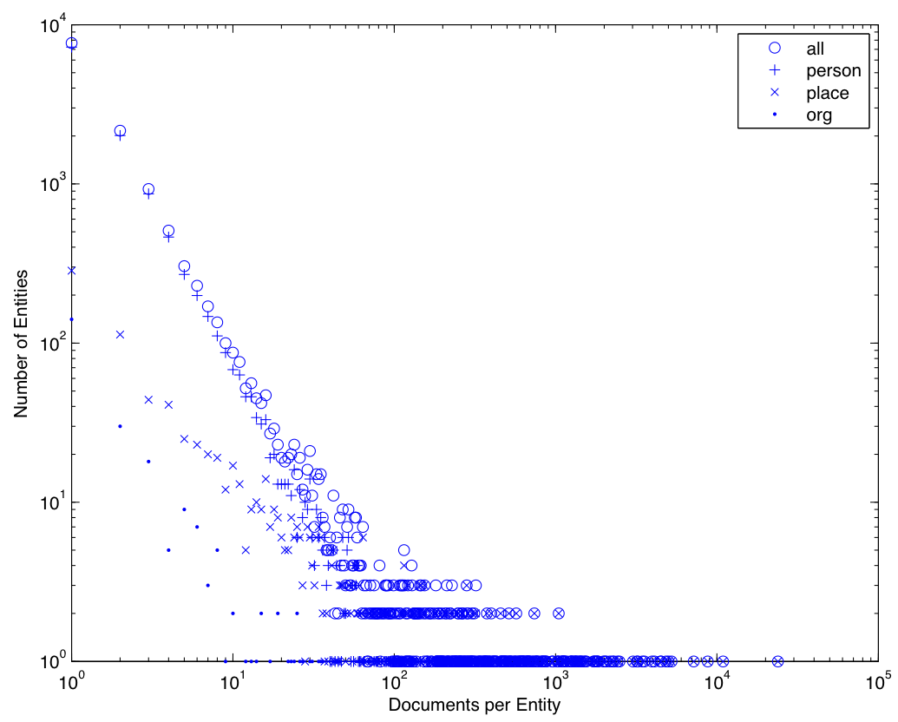
Reuters Corpus V1 (NIST) 1996-08-20 to 1997-08-19 (Released 2000-11-03
810,000 Reuters news blurbs
Picked 70,000 and found 13,000 entities
A is a 70Kx13K associative array with 500K entries
Power laws everywhere
Number of persons >> number of places
Number of document/places>> number of document/person
Notes:
Reuters corpus consists of a large amount of power law data.

Slide 34
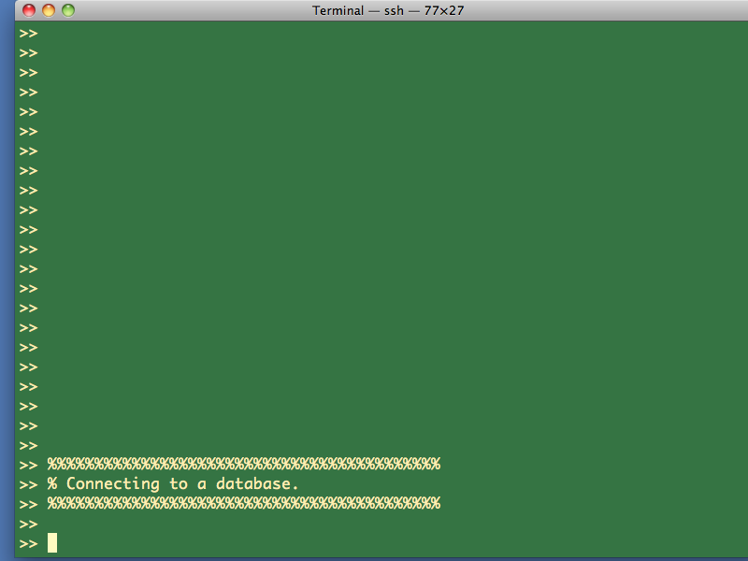
Notes:
34
Proceed to demo.

Slide 35
Summary
Web evolution has resulted in a new class of technologies for
Display (game interfaces)
Analysis (D4M)
Storage (triple stores)
D4M is a novel technology that allows complex analytics to be implement with significantly less effort than traditional approaches
D4M is built on composable associative arrays which admit linear algebraic manipulation
Notes:
Summary.

Slide 36
Example Code & Assignment
Example Code (end of Lecture 3 and start of lecture 4)
d4m_api/examples/2Apps/1EntityAnalysis
d4m_api/examples/2Apps/2TrackAnalysis
Assignment
None
Notes:
Examples and homework.

